Slide 1


Capstone Presentation Understanding and Improving Water Quality in California
Jesus Suarez

Slide 2
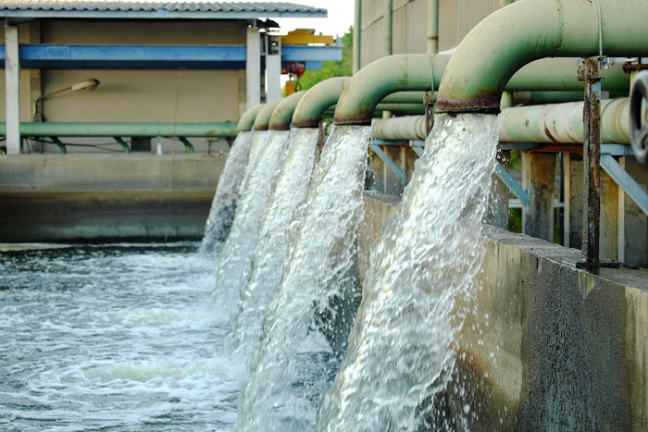
Problem Statement
Water quality varies statewide in California. To reduce the impact of poor water purity on the state population by 20% in the next two years, it is crucial to understand the chemical and physical properties of water and their correlations.

Slide 3
Scope of Solution Space
This project aims to:
- Correlate the chemical and physical properties of water (such as Electrical Conductance, Dissolved Oxygen, Temperature, and pH).
- Establish relationships, specifications, and critical properties of water quality.
- Identify key parameters and counties with significant water quality issues.

Slide 4

Introduction
Water quality is a fundamental aspect of public health and environmental sustainability, particularly in a diverse state like California, where variations in water purity can have significant implications. Dissolved Oxygen (DO) levels are a key indicator of water quality, influencing both aquatic life and overall ecosystem health.

Slide 5
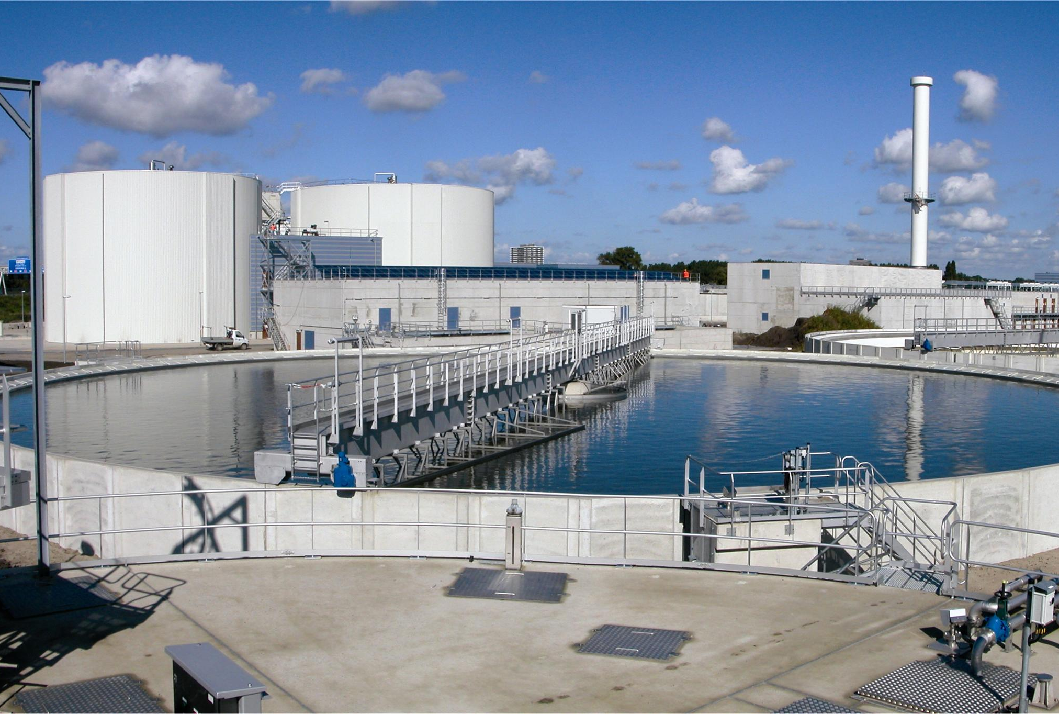
Data Wrangling
The data wrangling process involved several steps to clean, transform, and prepare the data for analysis. The main dataset used in this project was the field data result of the state of California Water Quality Analysis, which contained various measurements from different stations.

Slide 6
Data Wrangling (cont.)
Specific criteria were applied to remove outliers and erroneous data points:
Dissolved Oxygen: Filtered to include values greater than 0 and less than 15.
pH: Filtered to include values greater than 0 and less than 14.
Electrical Conductance: Filtered to include values greater than 0 and less than 500.
- Water Temperature: Filtered to include values greater than 0 and less than 100.

Slide 7
Exploratory Data Analysis (EDA)
This EDA provides an initial understanding of the dataset, highlighting important water quality parameters and their relationships:
- The mean dissolved oxygen across counties ranges from approximately 6 to 12 mg/L.
- The mean pH across counties varies from 7 to 9.
- The mean electrical conductance across counties ranges widely.
- The mean water temperature across counties ranges from approximately 15°C to 25°C.

Slide 8
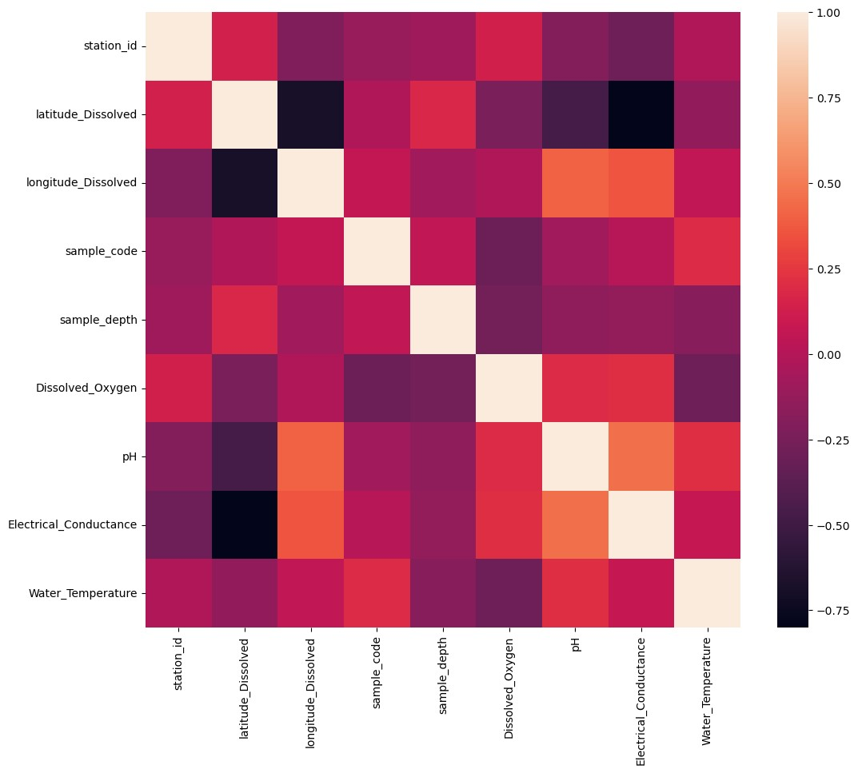
Correlation Analysis
Dissolved Oxygen and pH show a moderate positive correlation.
pH and Water Temperature show a weak positive correlation.
- Electrical Conductance doesn't show a clear correlation with other parameters.

Slide 9
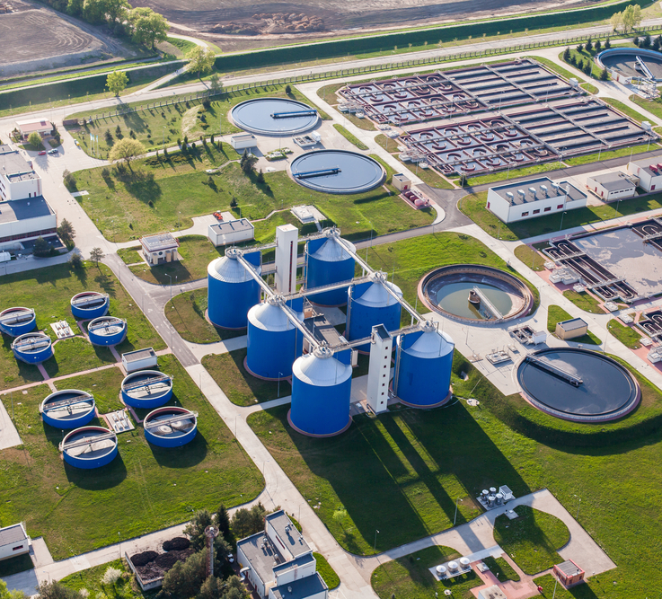
Preprocessing and Training Data
Data preprocessing is essential to ensure the dataset is clean, consistent, and suitable for training machine learning models. The data was split into training and testing sets using a 70-30 ratio. The target variable for this analysis was Dissolved Oxygen in water.
Dummy Regressor confirmed that predicting the mean Dissolved Oxygen yields poor results, with R² close to 0.

Slide 10
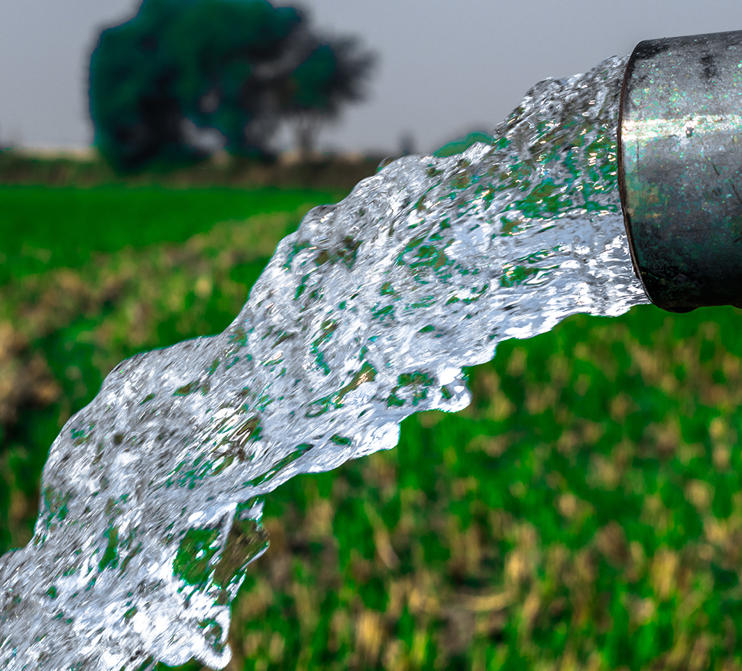
Modeling
The modeling phase involved selecting and evaluating different regression models to predict the Dissolved Oxygen level in water samples. The following models were considered:
1. Dummy Regressor
2. Linear Regression
3. Random Forest Regressor

Slide 11
Model Performance
The Random Forest Regressor outperformed the Dummy Regressor and Linear Regression models, showing the highest R² and lowest error metrics. This model is recommended for predicting Dissolved Oxygen levels based on the given features.
Model | Training MAE | Test MAE | Training MSE | Test MSE | Training R² | Test R²
Dummy Regressor | 1.48 | 1.47 | 4.26 | 4.12 | 0.00 | -0.004
Linear Regression | 1.14 | 1.11 | 2.63 | 2.70 | 0.38 | 0.34
Random Forest | 0.40 | 1.00 | 0.29 | 2.09 | 0.97 | 0.51

Slide 12
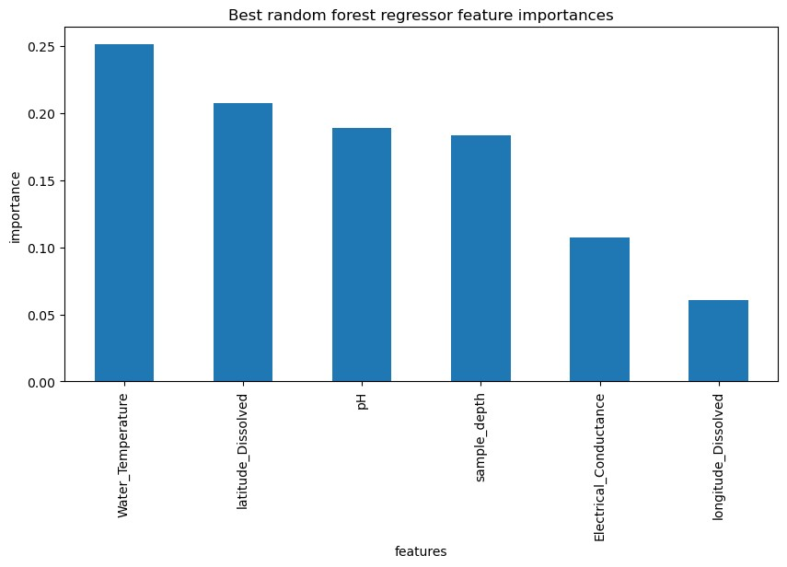
Feature Importance
The feature importance chart reveals that Electrical Conductance, Water Temperature, and pH are the top three influential features for predicting Dissolved Oxygen levels.

Slide 13
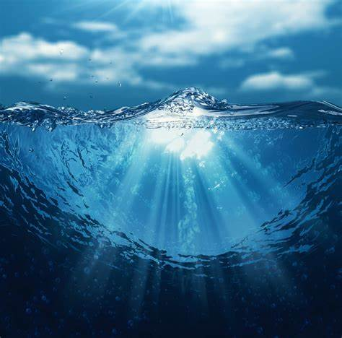
Conclusion
This report highlights the critical steps undertaken to understand and improve water quality across California, focusing on predicting Dissolved Oxygen (DO) levels using various chemical and physical water parameters. The Random Forest Regressor model emerged as the most effective in predicting DO levels, outperforming simpler models like the Dummy Regressor and Linear Regression.

